Slide 1

OTT Big Data Analysis

Slide 2
Agenda
Architecture
Data Overview
Analysis
Visualizations
Summary

Slide 3








Architecture
ETL
Analysis
BI
Source

Slide 4
Data Overview
Amazon Prime Video
Movie Name
Language
Imdb rating,
Maturity rating,
Netflix
Country wise Movies & Series watched
Ratings, genre & duration
Title, cast & Description
Disney
Movie wise awards, votes and ratings
Director, writer and actors
release year, language and country

Slide 5

Analysis
14 Questions
Apache Hive
Spark SQL
PySpark

Slide 6
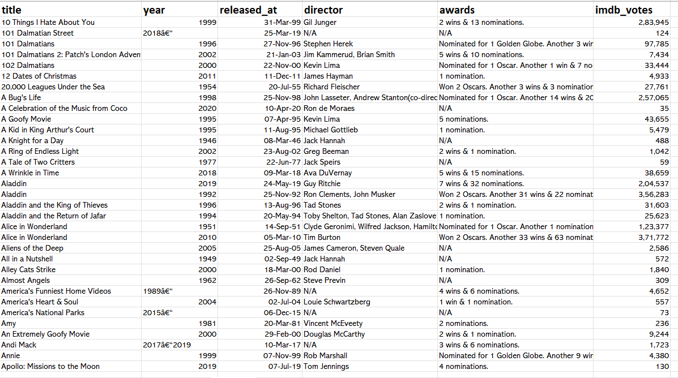
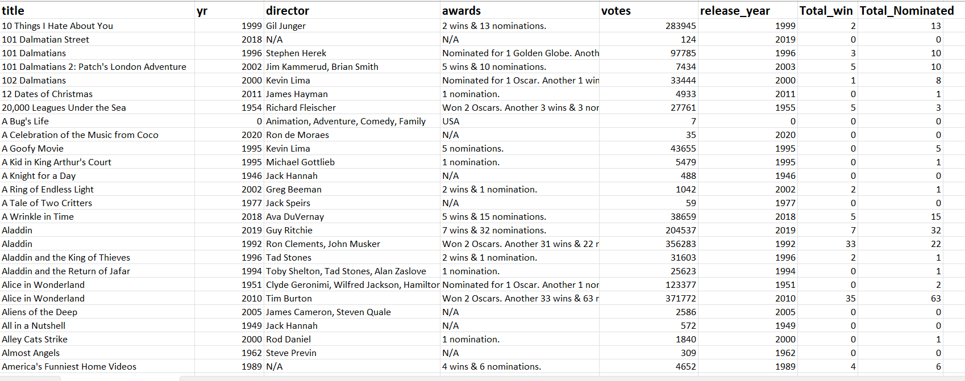
Disney Hotstar Data
Before Processing
After Processing

Slide 7
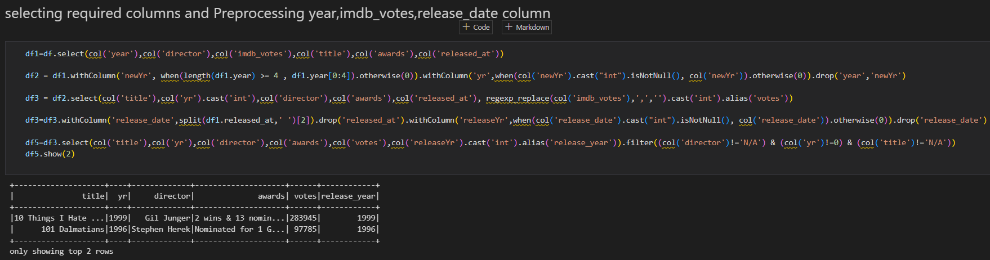
Pre-Processing Disney Hotstar Dataset

Slide 8
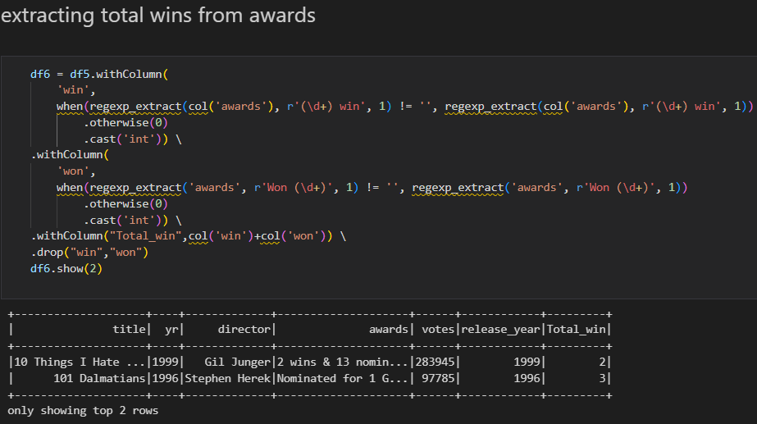
Extracting Wins Disney Hotstar Dataset

Slide 9
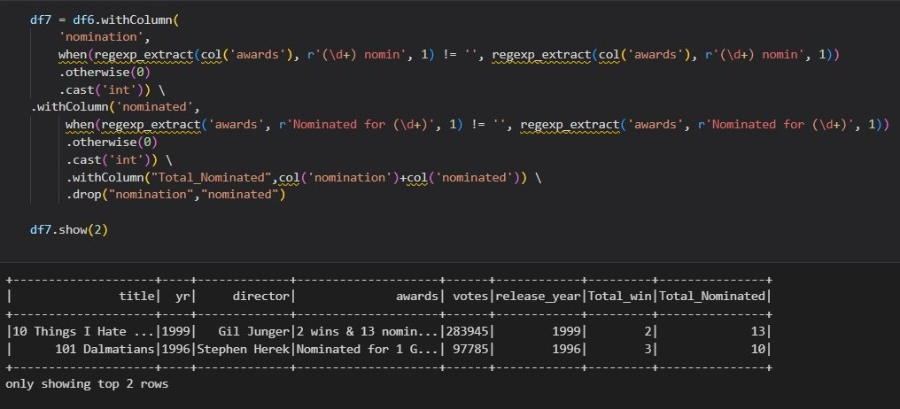
Extracting Nominations Disney Hotstar Dataset

Slide 10
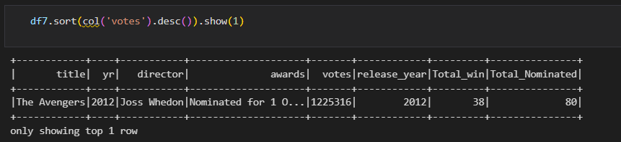
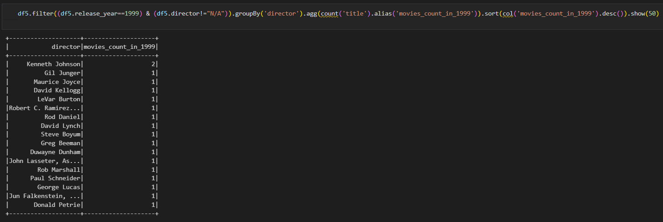
Disney Hotstar Data Frames API
Which director’s movies has the highest votes? And Which year?
Total number of movies released in 1999, Director wise

Slide 11
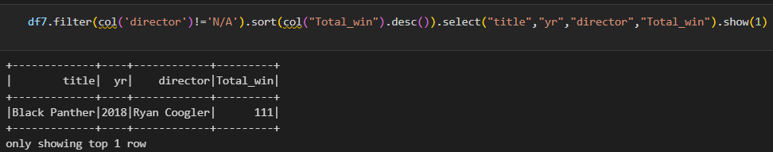
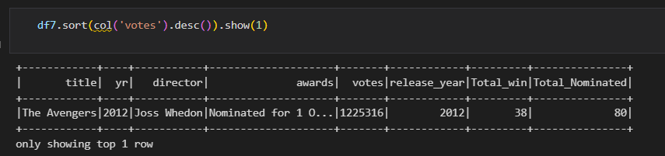
Disney Hotstar Data Frames API
Which year movies got highest awards? And which Directot?
Which director’s movie has the highest votes? And which year?

Slide 12
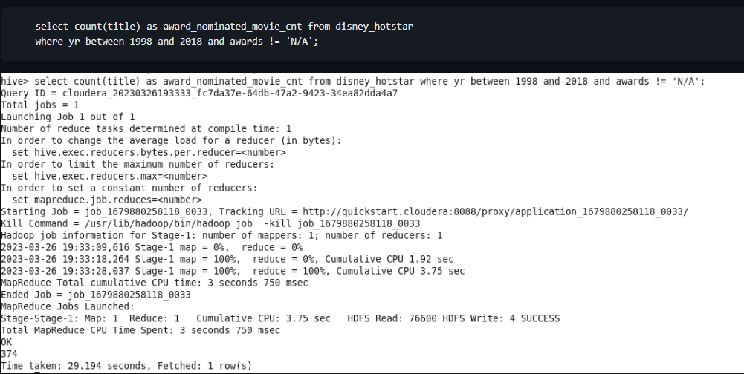
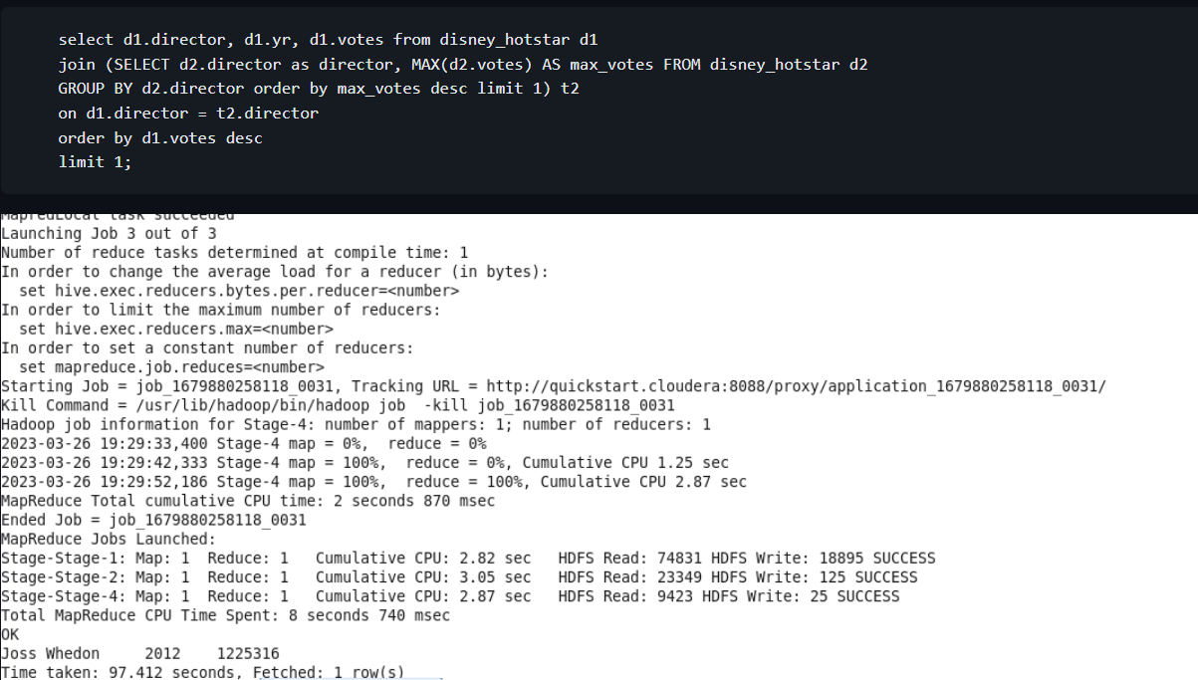
Disney Hotstar Hive
Total number of movies nominated for awards between 1998-2018?
Which director’s movie has the highest votes? And for which year?

Slide 13
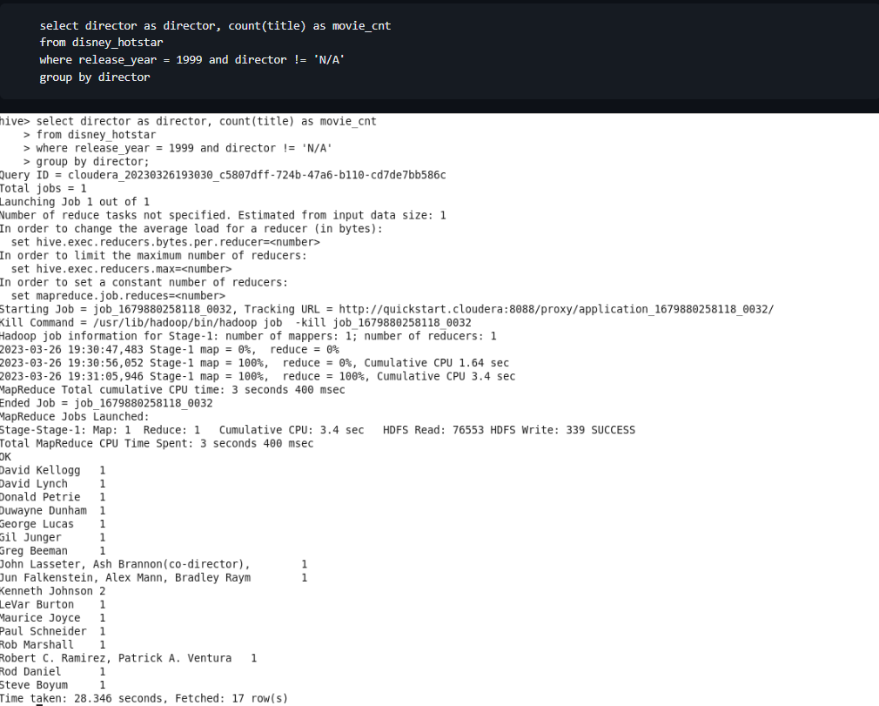
Disney Hotstar Hive
Total Number of movies released in 1999, director wise

Slide 14
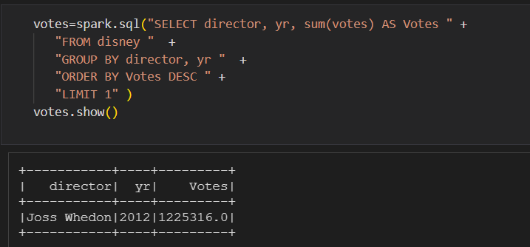
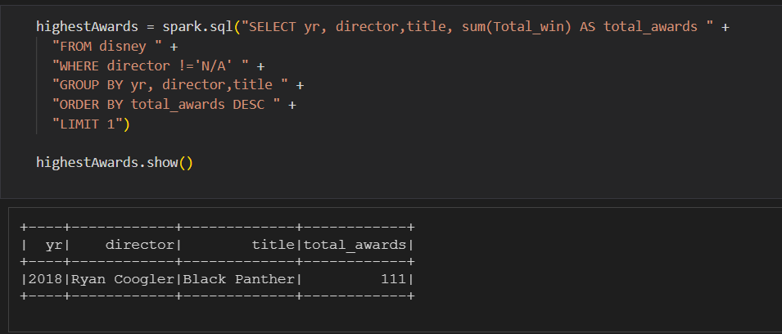
Disney + Hotstar Spark SQL
Which Director’s movies has the highest votes and for which year?
Which year movie got highest awards?

Slide 15
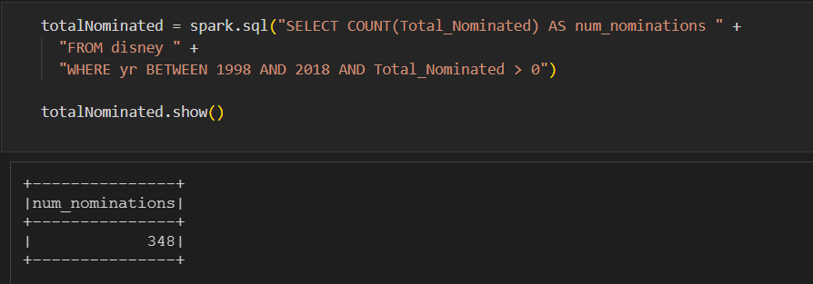
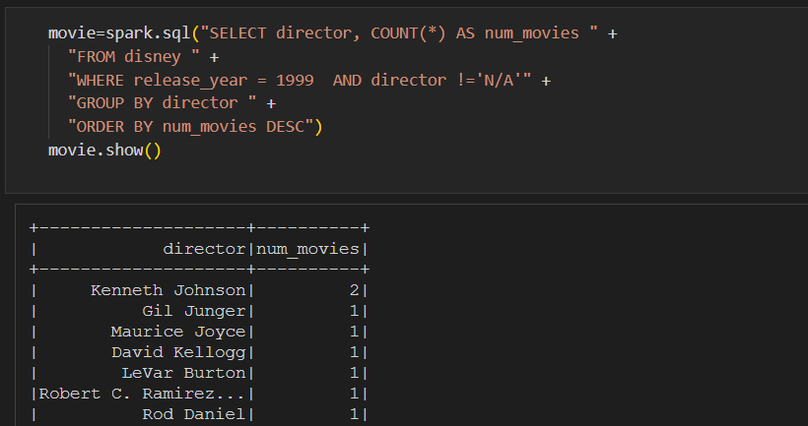
Disney + Hotstar Spark SQL
Total no of movies nominated for awards between 1998-2018
Total no of movies released in 1999, Director wise

Slide 16
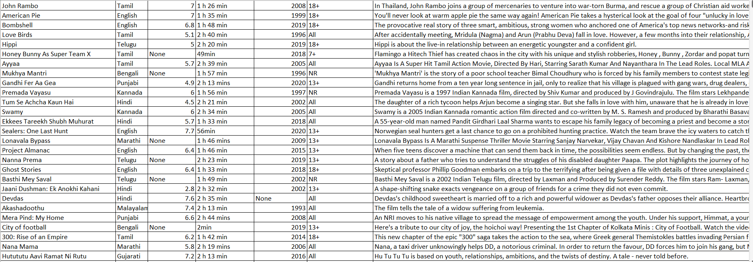
Amazon Prime Data

Slide 17
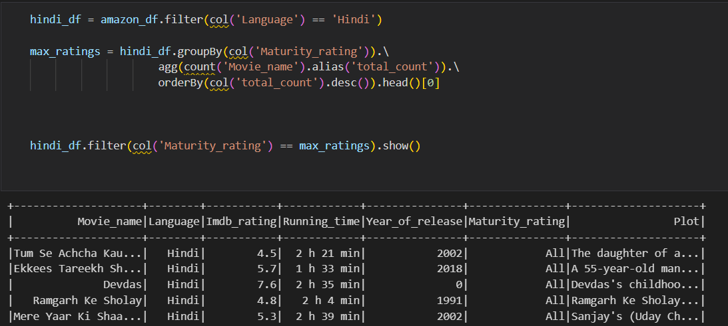
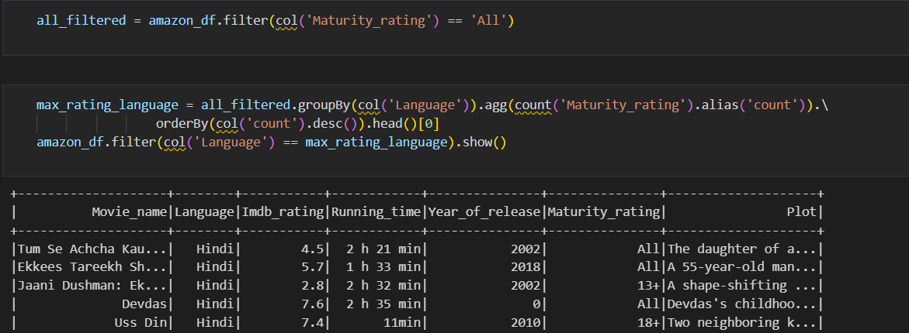
Amazon Prime Data Frames API
Which age Group is watching Hindi Movies, with movie titles
Which are the languages, movies highly watched by people of all ages?

Slide 18
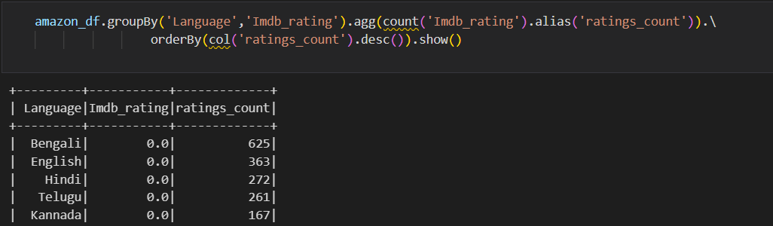
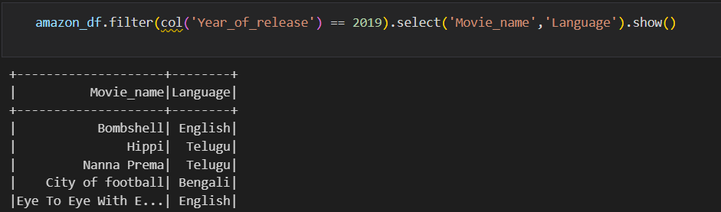
Amazon Prime Data Frames API
Review the total number of movie ratings by language wise, and what are the movies that are high maturity rating?
Review the movie names and languages names in the year of 2019

Slide 19
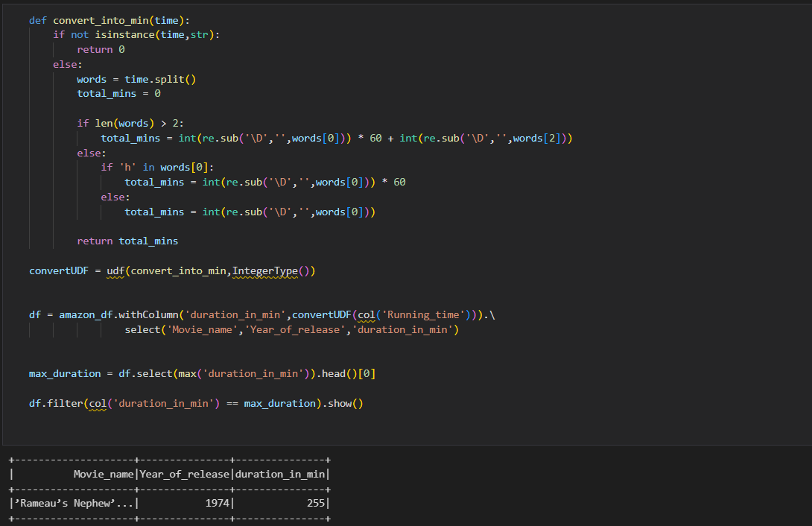
Amazon Prime Data Frames API
Which movie has the highest running duration and in which year?

Slide 20
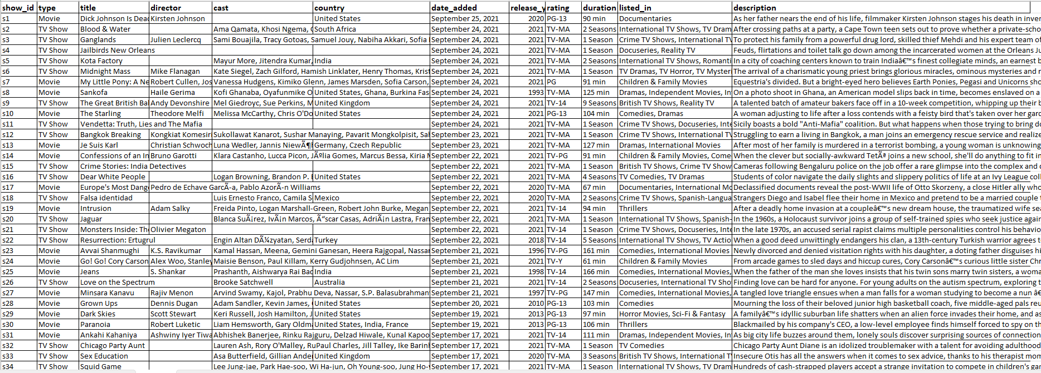
Netflix Data

Slide 21
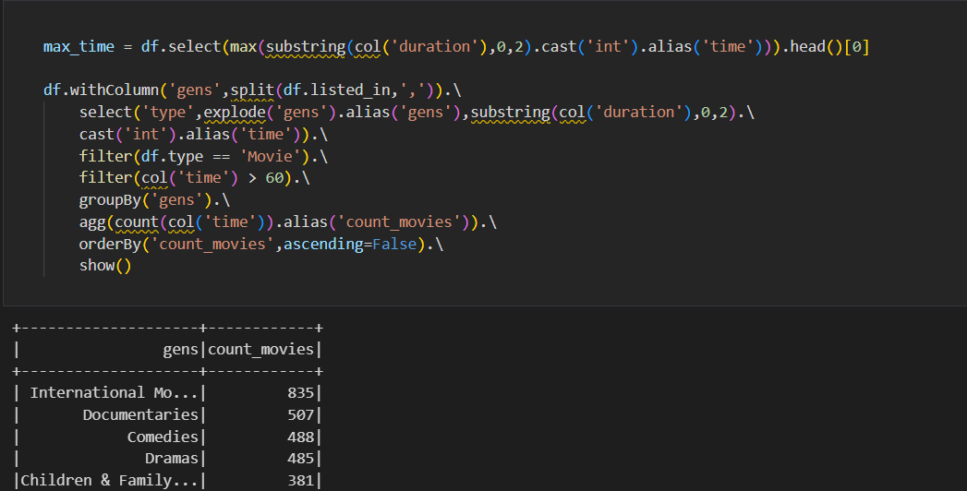
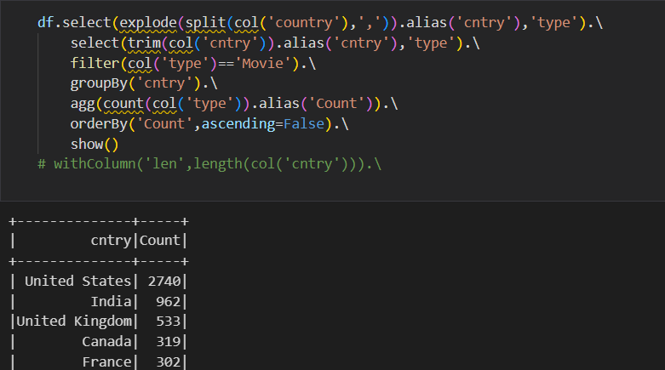
Netflix Data Frames API
What type of movies has highest duration (more than 1 Hr.)? total number of movies of that type
In which country highest movies were released?

Slide 22
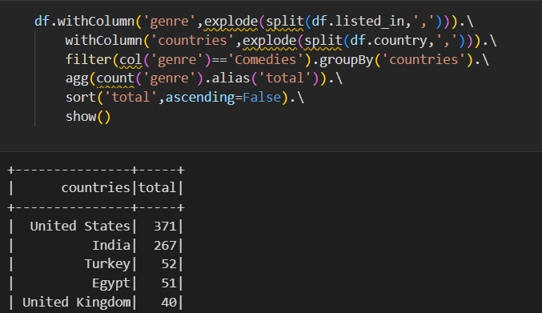
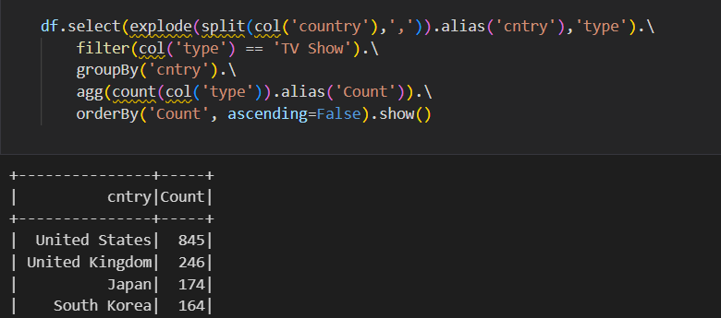
Netflix Data Frames API
Which country has highest comedy movie category? And the total number of comedy movies, by show id.
Which country has the highest tv shows, by show.

Slide 23
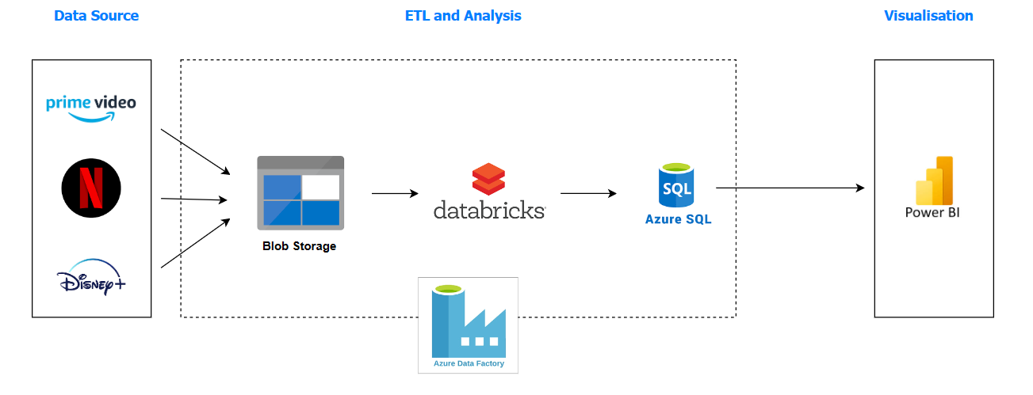
Pipeline

Slide 24
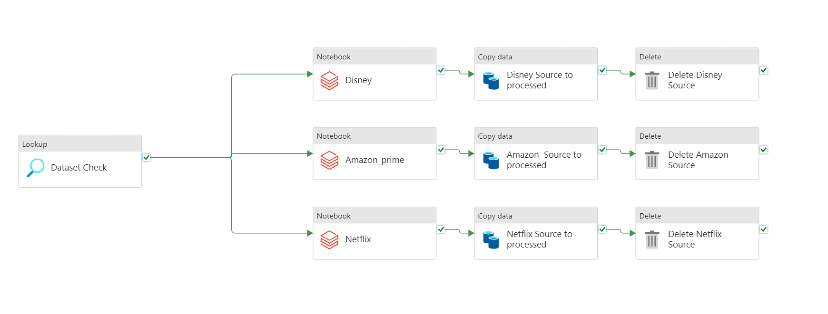
Azure Data Factory

Slide 25

Challenges
Data Pre-Processing
Optimization
Formatting the Nominations & awards of movies in Disney Dataset
Retrieving year from the date column
Exploding the genre column from the Netflix Dataset
Partition & Bucketing in Apache Hive
Cache & Persisting in Apache Spark
Only one Pipeline for all 3 Datasets in Azure Data Factory

Slide 26


Summary

Slide 27




Thank you
GROUP 2

